Slide 1
Hackathon 2024: ACCEPT ALL COOKIES

Slide 2



Team Name and Members
2
FATIMAHZIYA AT : TEAM LEAD
CSE SEMESTER 8
TECHNICAL INTEREST : WEB DEVELOPMENT
PROJECTS : FOOTBALL LIVE SCORE AND PREDICTION , VOICE CLONING SYSTEM , SALINE STAND WITH IR SENSOR
ASWIM MM : DOCUMENTATION
CSE SEMESTER 8
TECHNICAL INTEREST : UI/UX DESIGNER
PROJECTS : Created several application interfaces for an internship, Won the top honor for creating a learning website for a nationwide hackathon, Created a web interface for a file transfer for a college project.
SARATHKUMAR K : DATA/ ML ENGINEER
CSE SEMESTER 4
TECHNICAL INTEREST : GAME DEVELOPMENT
PROJECTS : REMOTE MOUSE/KEYBOARD APP,THYROID DETECTION SYSTEM

Slide 3


Team Name and Members
2
JEEVA VINOD : DATA/ ML ENGINEER
CSE SEMESTER 6
TECHNICAL INTEREST : DATA SCIENTIST/ANALYST
PROJECTS : AUTHORISED ACCESS USING ANPR TECHNOLOGY,FILE AUTOMATION,WEB SCRAPING AND VISUALISATION
ARFAN BT : SOFTWARE ENGINEER
CSE SEMESTER 4
TECHNICAL INTEREST : DSA, WEB DEVELOPMENT
PROJECTS : EXPENSE TRACKER, LUNG CANCER DETECTION SYSTEM

Slide 4
LLM Problem Statement: Why
3
The problem statement is “Develop a Customizable Tool: Design your AI tool to be customizable so that users (including SMEs) can specify the document type and desired level of detail in the summary.” Reasons for choosing are :
Flexibility for SMEs (Small and Medium Enterprises): Many SMEs lack the resources for complex AI solutions. A customizable tool allows them to tailor the AI to their specific needs and document types, making it more accessible and valuable..
Improved User Experience: Users feel empowered when they can control the functionality of the tool. Customization allows them to find summaries that best suit their needs and working style. Also reduce frustrations if they lack less details .
Focus on Specific Document Types: By specifying the document type, users can guide the AI to focus on relevant information, potentially improving the accuracy and relevance of the summaries.
Tailored for Domain Knowledge: Customization allows users to potentially incorporate domain-specific knowledge into the AI, leading to more accurate and insightful summaries within their field.
Future-Proofing:It can be adaptable and scalable.

Slide 5
LLM Business Problem: What
4
The problem faced by SME to develop this product are :
Inefficient Use of Time: Sifting through large volumes of documents to extract key information is time-consuming. SMEs often lack dedicated personnel for information analysis, leading to delays and missed opportunities.
Difficulty Prioritizing Information: Not all information is equally important. Generic summaries might not highlight critical details or bury them in unnecessary text.
Knowledge Gaps in Specific Domains: SMEs might operate in specialized fields where generic summaries lack understanding of relevant terminology and context.
Limited accessibility for SMEs: Complex AI solutions can be expensive and require technical expertise, making them inaccessible for many SMEs.
Improved Decision-Making: Customizable summaries ensure users focus on the most relevant information for informed decision-making.
Information overload: Businesses deal with a constant influx of documents - emails, reports, contracts, research papers - making it difficult to stay on top of key information.

Slide 6
Solution Overview: How
5
DATASET COLLECTION :
We collected datas from kaggle , hugging faces and also we created dummy datas for the area we work in such as legal , educational and financial.
DATASET PREPROCESSING :
In this step we convert all the data into text .
MODEL SELECTION :
We use Bidirectional and Auto-Regressive Transformer. It's a powerful AI model developed by Facebook that uses a technique called denoising sequence-to-sequence pre-training for tasks like natural language generation, translation, and comprehension. For legal documents we use facebook/bart-large-cnn , financial :facebook/bart-base and research documents : mrm8488/bert-mini2bert-mini-finetuned-cnn_daily_mail-summarization.
SUMMARY GENERATION :
Generate summary for the required text by using tokenization and masking
DEVELOPED UI/UX :
We use an application FIGMA for creating a user friendly interface .
IMPLEMENTATION :
We use django framework for implementation. And we created AI customisable summarisation tool

Slide 7
Economic Logic
6
Benefits of the product in economic base would be the following :
Increased Revenue and Market Share: A customizable AI summarization tool can attract a wider range of users, including SMEs, leading to increased market share and potential revenue growth.
Reduced Costs: Businesses can save time and money by using AI to process information faster and avoid the need for additional human resources for summarization tasks.
Improved Efficiency and Productivity: Faster information processing translates to quicker decision-making, improved workflow, and ultimately, increased profitability.
Competitive Advantage: Businesses that leverage AI for efficient information processing can gain a competitive edge by making faster and more informed decisions.

Slide 8
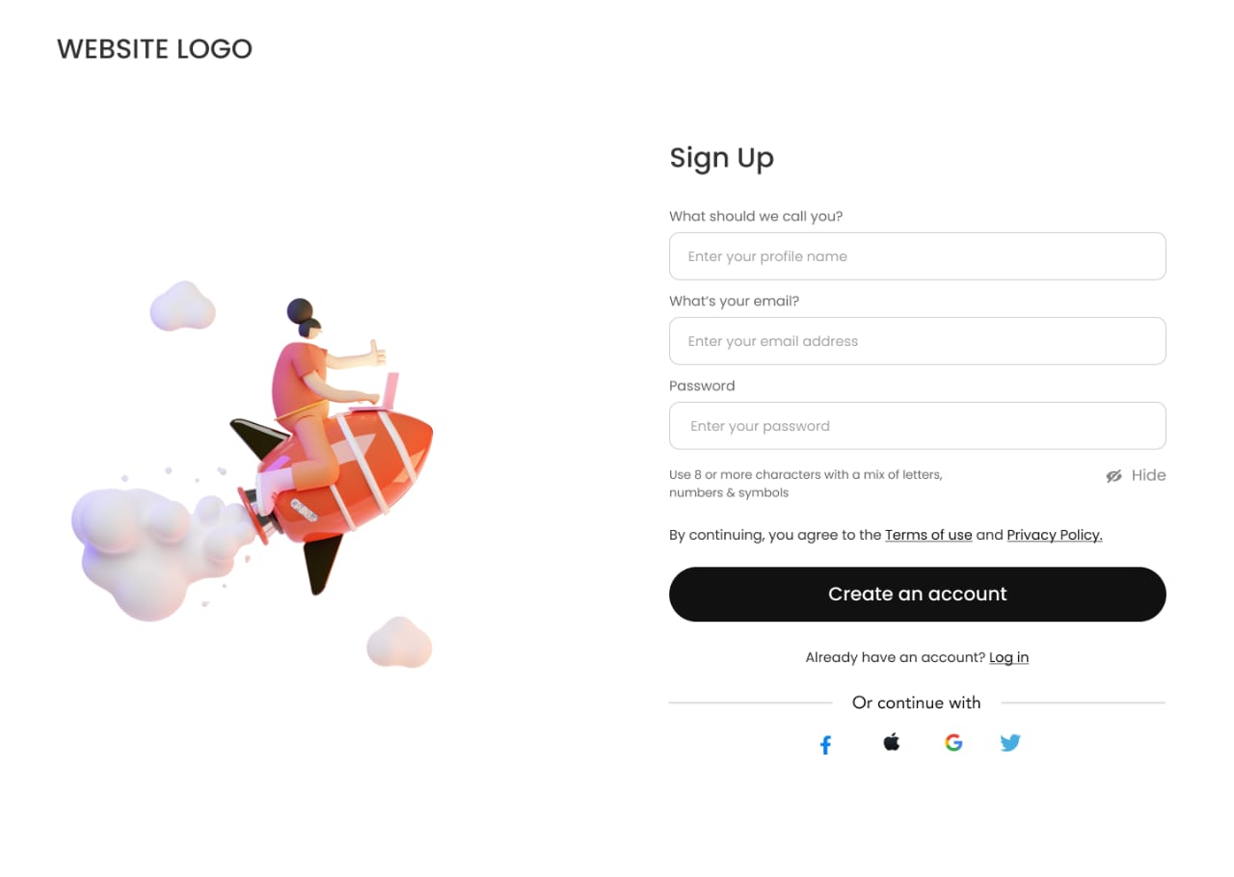
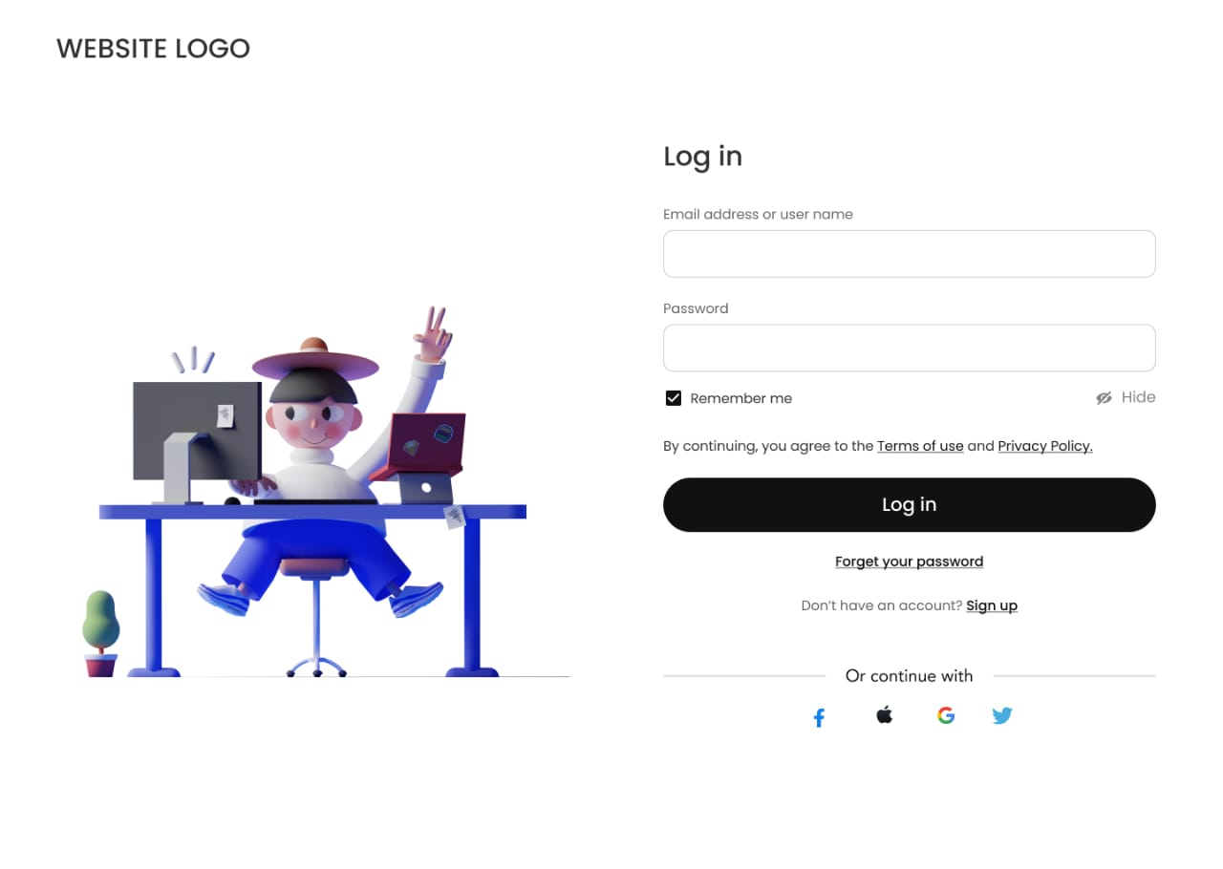
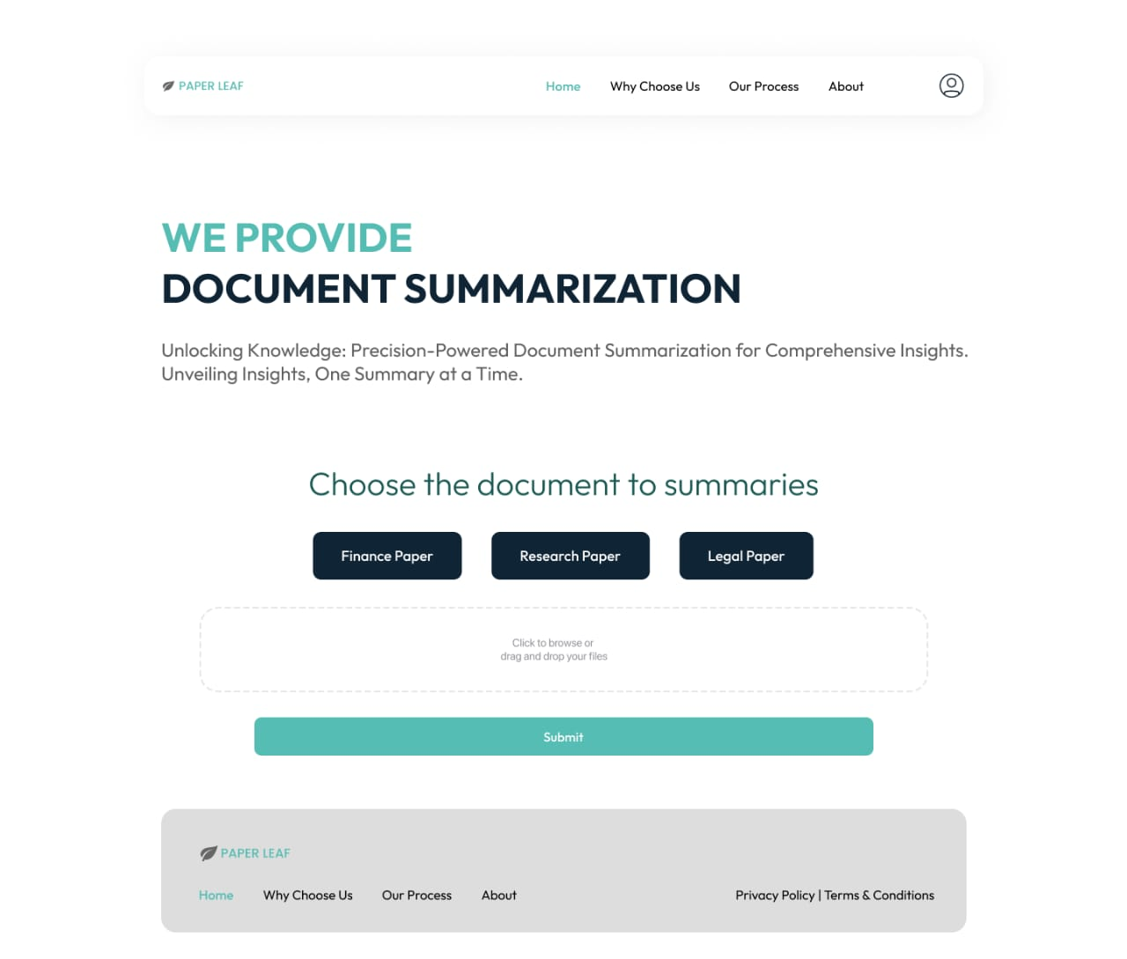
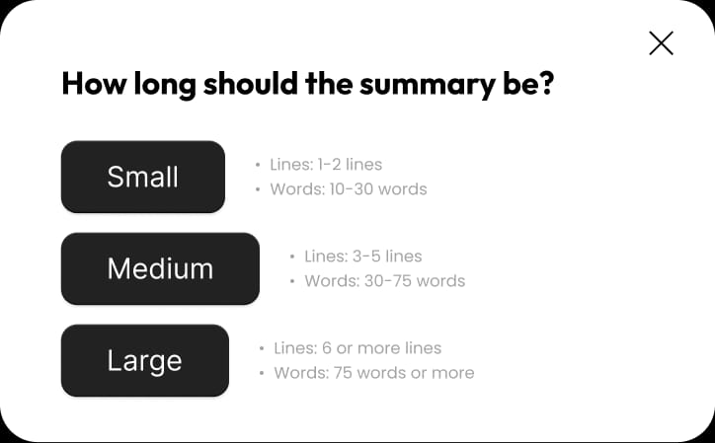
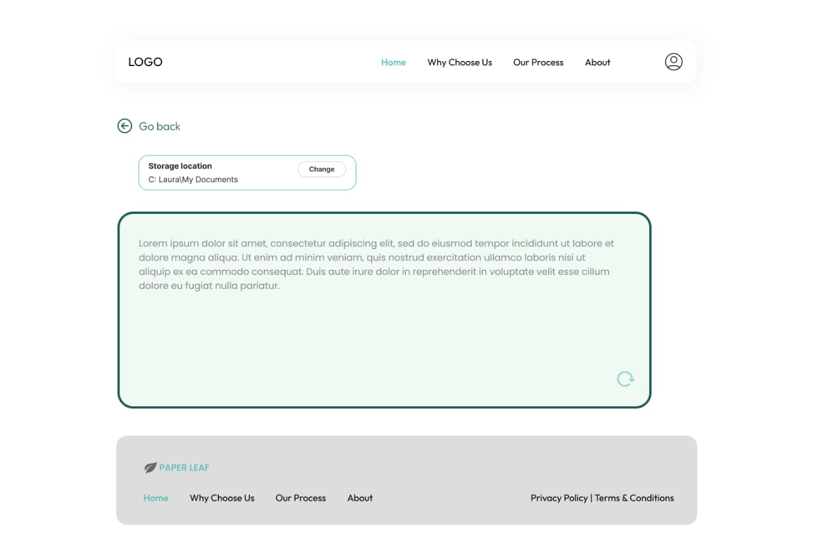
Project Demo
7

Slide 9




THANK YOU

